Slide 1
Horizon Travels Presentation
William Forber
Student Id: 22015706

Slide 2
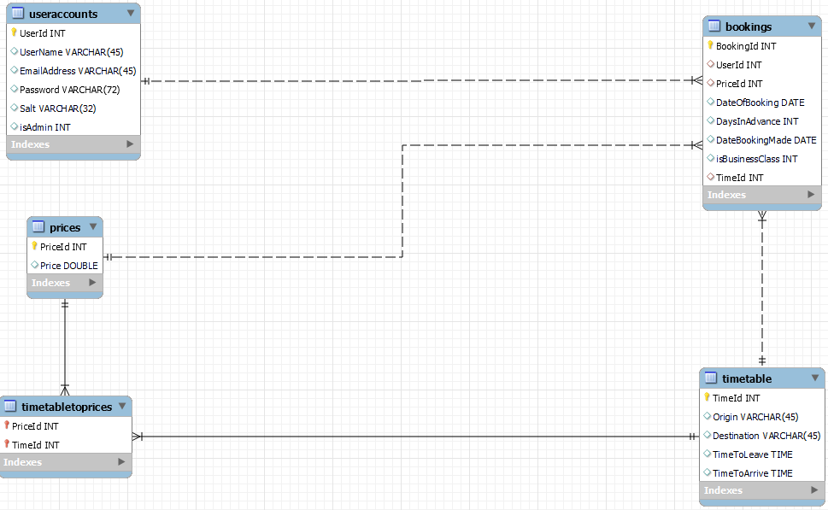
Database design
Entity relationship diagram

Slide 3
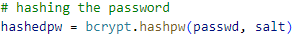
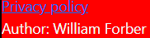
Legal
All passwords stored in the database are hashed so even if the database is hacked, users passwords should be safe.
SQL injection is prevented by formatting user inputs into strings for a statement before it is executed.
Users can read the privacy statement located at the bottom of every page.

Slide 4
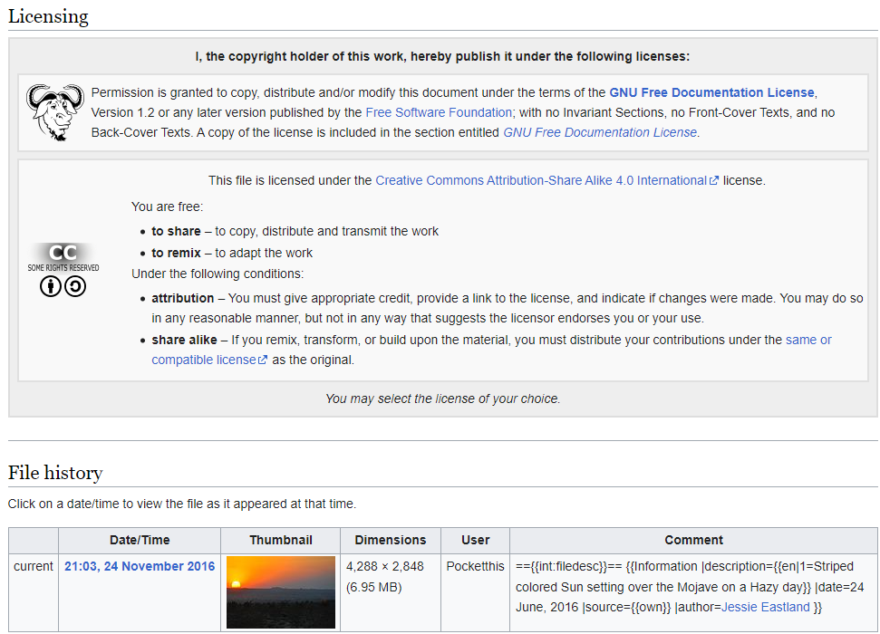

Legal Continued
The background image used is free to copy and distribute, meaning that the copyright designs and patents act is followed
The logo was designed by me

Slide 5
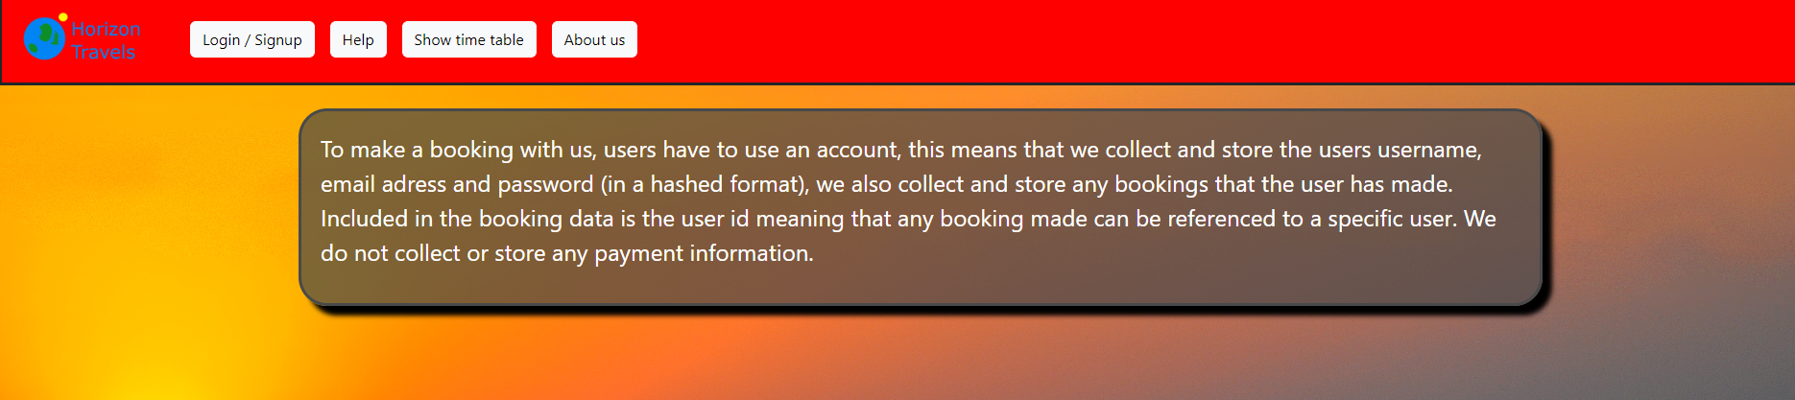
Ethical
The images used in this website are small so users on slow connections should still be able to use the website, this also reduces the carbon footprint.
The privacy statement is designed to be transparent so questions are answered without leaving any grey areas.

Slide 6
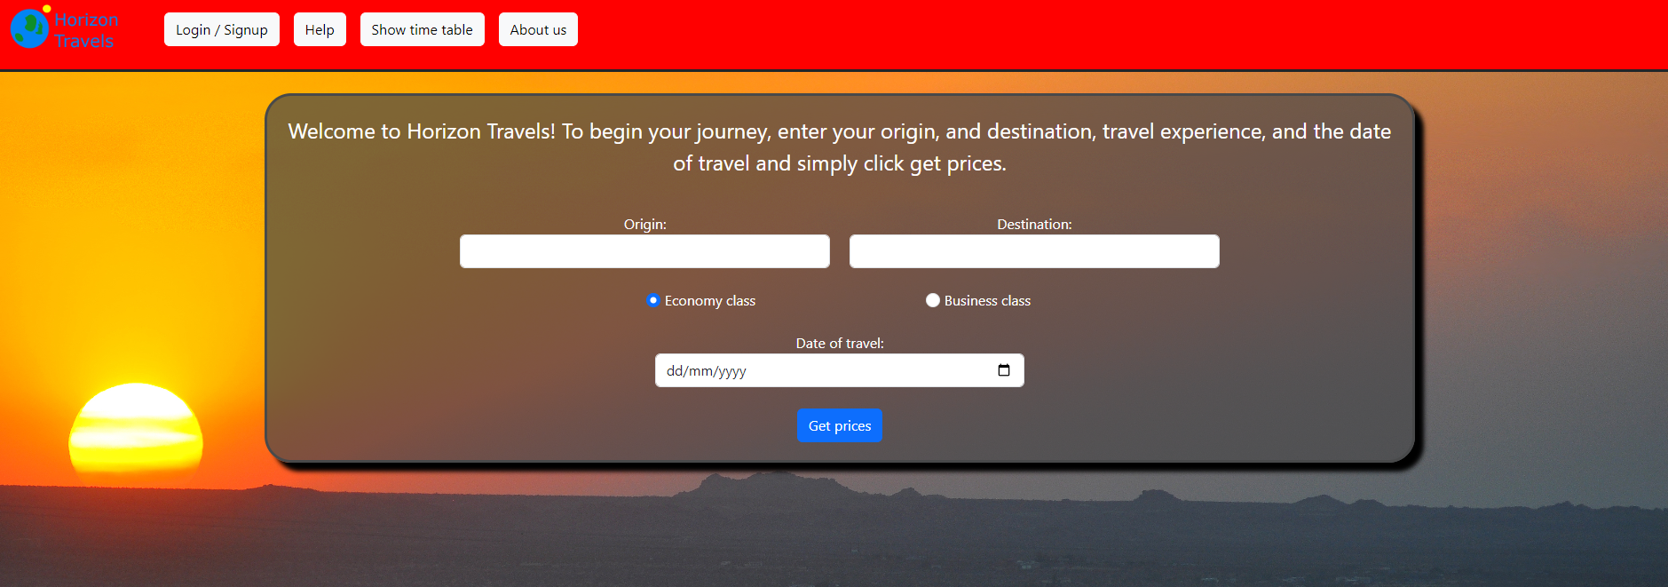
Social
My website is responsive allowing for mobile and tablet users to also use the website alongside desktop users.
Buttons and text is large allowing for anyone to be able to read and use my website
Partially transparent boxes are used around text, allowing for text to contrast well with the background image improving readability.

Slide 7
Professional
My website meets functional requirements being (users can make / delete bookings).
My website also meets non functional requirements being (protecting from SQL injection and ensuring that the readability of my website is good).
My website only uses 2 images reducing file size which improves performance.

Slide 8
Website demonstration

Slide 9
Different technologies used:
Bootstrap, used to give a better structure to forms and enhance the look and functionality of buttons and the navbar
Python Flask, used to allow the website to communicate to the database and provides most validation steps,
Java script, used to add validation to the date input and the journey select form as will be seen below. I also used JavaScript for generating QR code receipts which was shown in the demonstration.

Slide 10
Validation example
Shown in the slides below are some examples of validation examples:

Slide 11
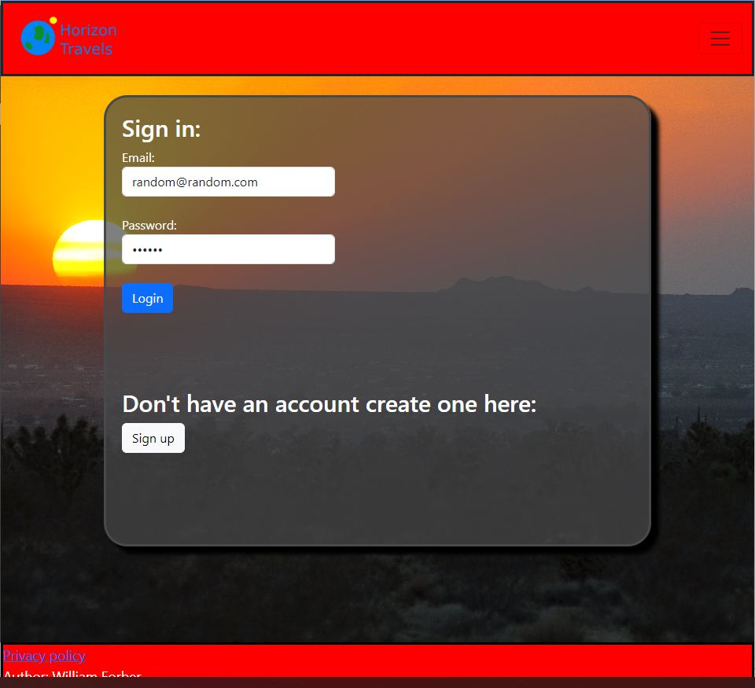

Invalid login info inputted
Results in →

Slide 12
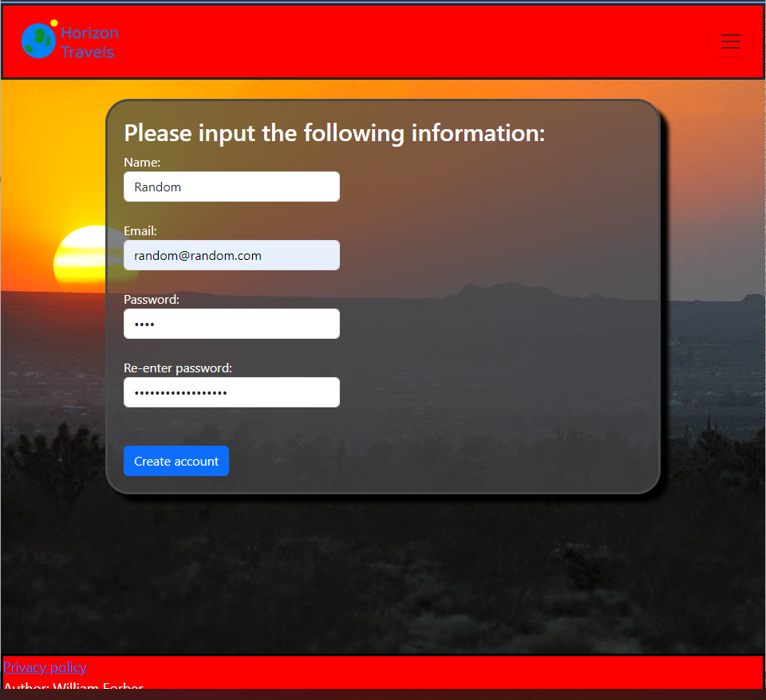
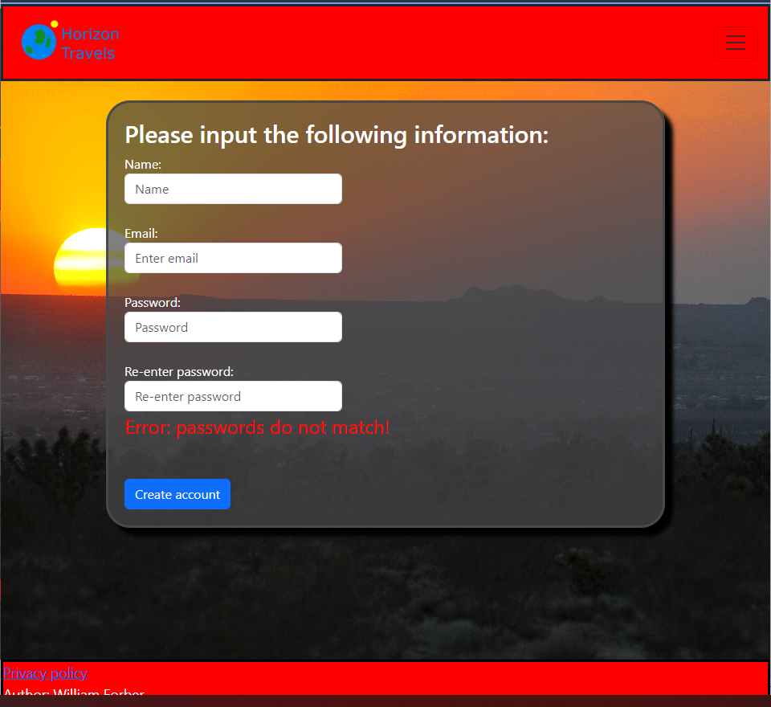
Different passwords used when signing up
Different passwords used when signing up
Results in →

Slide 13
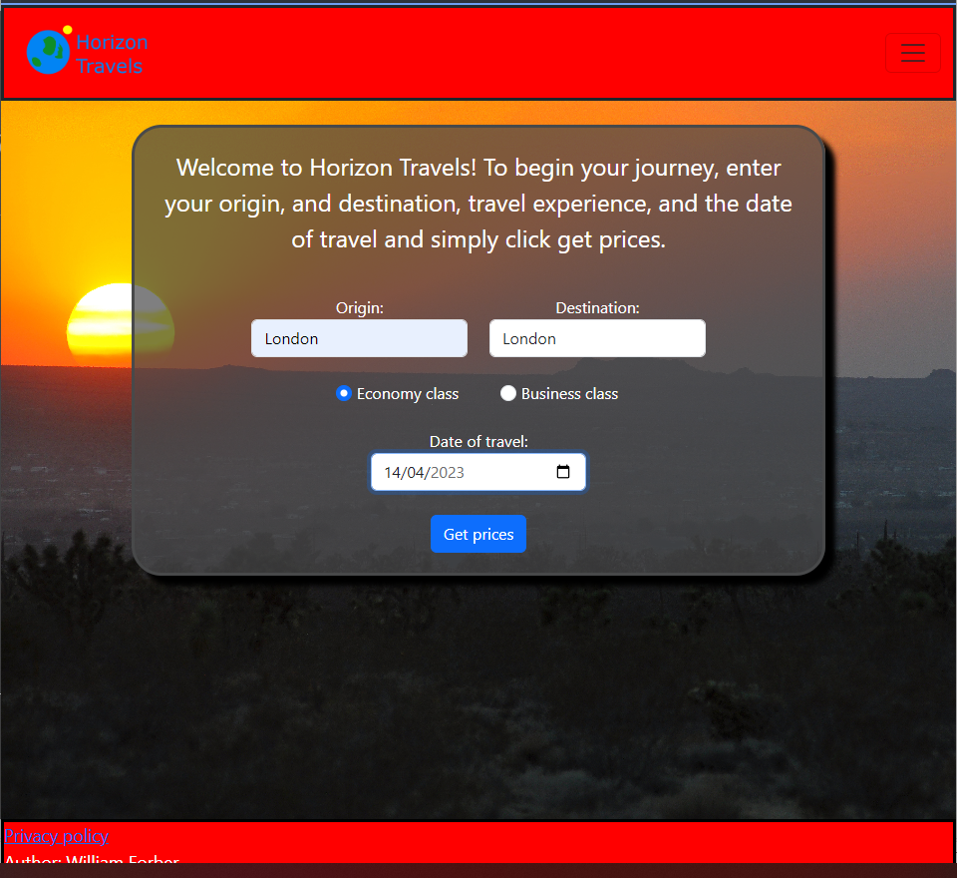
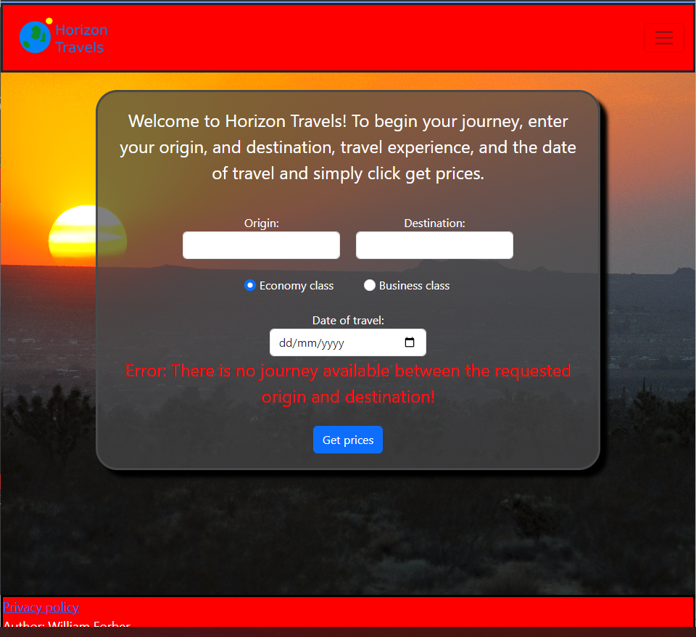
Invalid journey requests
Results in →

Slide 14
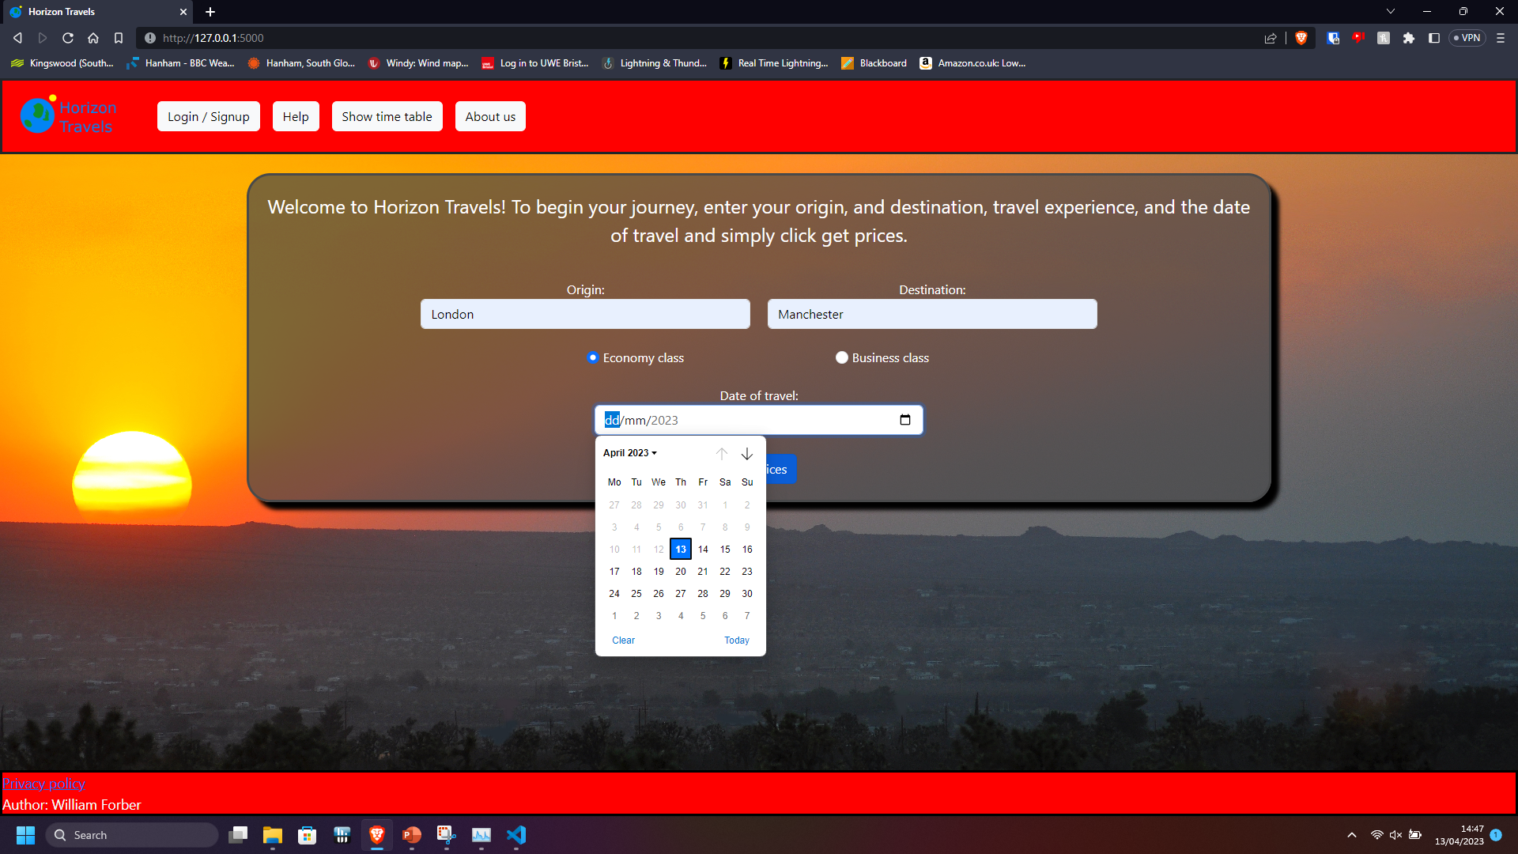

Booking in the past or too late
Here java script is used to stop the user making a booking in the past as well as preventing the user from making a booking more than three months ~(90 days) in the future.
Here is a example:
Date cannot be selected more than 90 days ~(3 months) in the
future:
Date cannot be selected in the past:

Slide 15
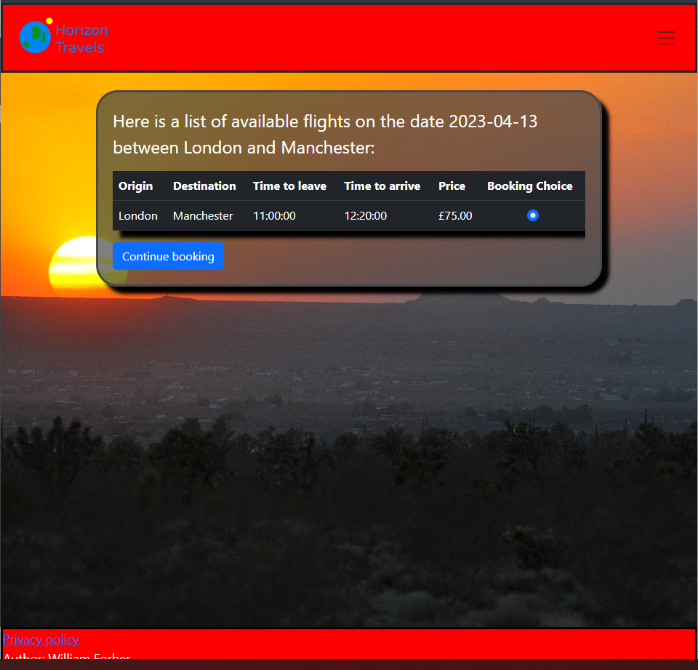
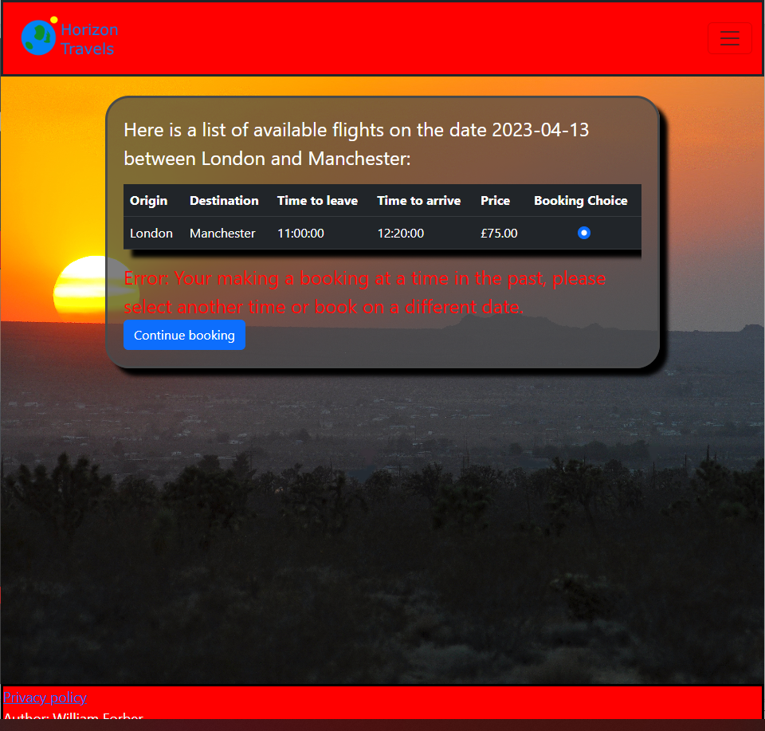
Booking a journey on the same day but the time to leave has surpassed the current time.
This validation uses JavaScript and checks weather the user is too late
To make a booking on the same day.
Results in →

Slide 16
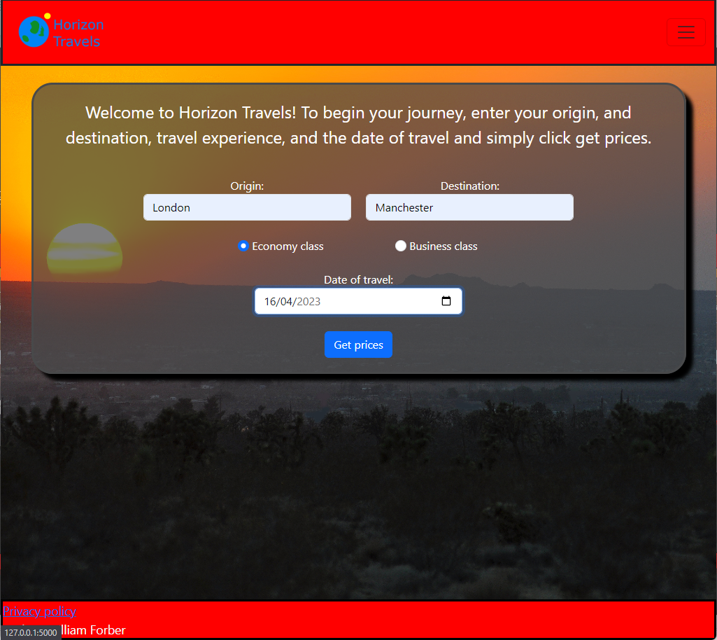
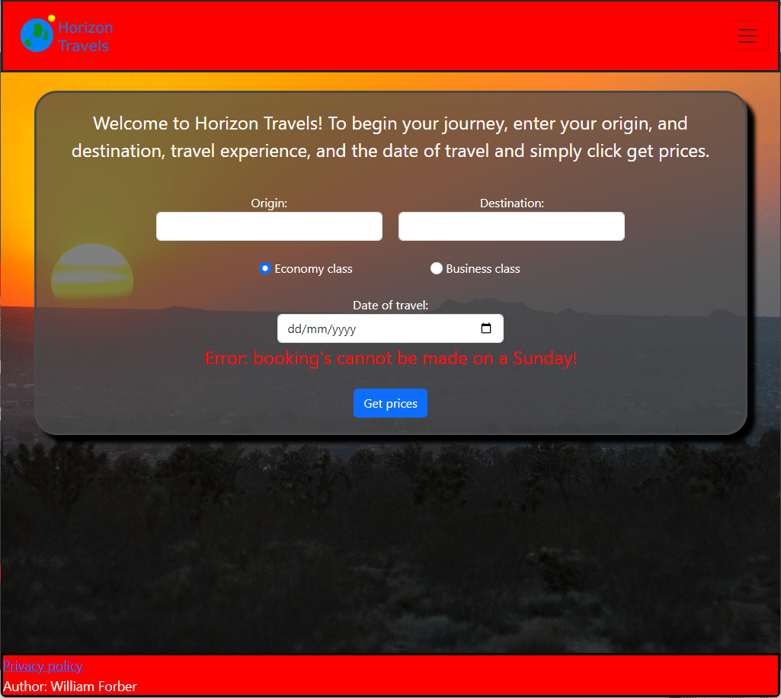
Booking a journey on a Sunday
Results in →

Slide 17
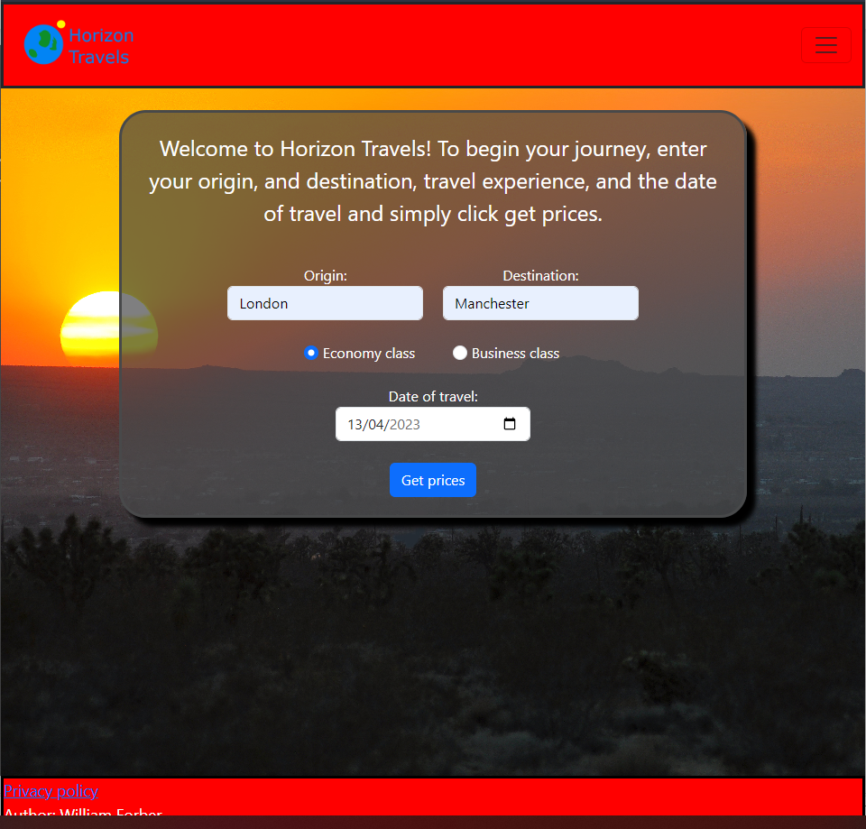
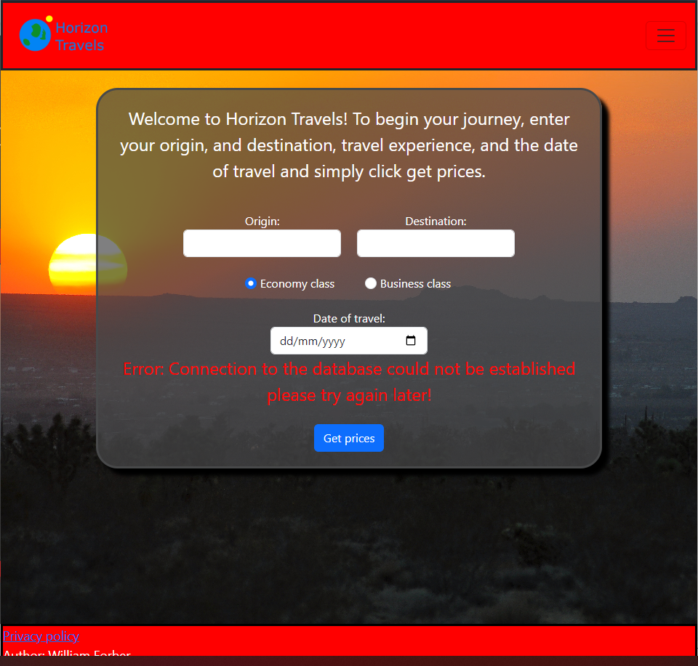
Connection to database lost
Done by stopping the my SQL
service
Results in →

Slide 18
What was missed ?
No option for return trips, trips have to be booked manually.
Only one seat can be booked at a time not multiple.
No options for different travel types e.g., taxi, train, coach only air travel.
Users cannot update bookings(change booking date) and can only cancel them and then rebook on the changed date.

Slide 19
Evaluation
Overall most of the targets for this project were met, because the user can make, delete bookings, change their information and delete their accounts. An administrator can generate a monthly report and run custom SQL statements in the browser, however a few things were missed the most severe thing being that return trips need to be booked manually, meaning that a return trip between Bristol and Manchester would need for the user to make two bookings one from Bristol to Manchester and one from Manchester to Bristol.
However since there is a way to make a return booking ( that is less refined) this problem is relatively small. And could be fixed in the future.
The rest of the issues are relatively minor and, the multiple seats problem shown previously can be circumvented by creating multiple accounts.

Slide 20
Thank you

